Slide 1

Company Profile (HVAC and MEP Solutions)
Email :- info@shalvin.org ,projects@shalvin.org
Contact :- 9327395916, 7802805114

Slide 2
About US
Welcome to Shalvin Technocrats LLP, where technical excellence and expertise merge to create an unparalleled experience in the realm of HVAC and MEP services. At Shalvin Technocrats LLP, we believe that every space deserves the perfect climate, and we are dedicated to transforming your vision into a reality. With a team of highly skilled engineers, technicians, and designers, we specialize in providing cutting-edge solutions for Heating, Ventilation, and Air Conditioning (HVAC) and Mechanical, Electrical, and Plumbing (MEP) systems.
Our technical prowess is unmatched, with a profound understanding of the intricate mechanics and complexities involved in HVAC and MEP systems. We combine this expertise with the latest advancements in technology to offer tailored solutions that optimize energy efficiency, improve indoor air quality, and enhance overall occupant comfort.
From concept design and system selection to installation, maintenance, and repairs, Shalvin Technocrats LLP excels in every phase of the project lifecycle. Our meticulous attention to detail ensures that every component is flawlessly integrated, resulting in seamless functionality and long-lasting performance.
With a customer-centric approach, we prioritize your unique requirements, budgetary constraints, and project timelines. Our team of professionals works closely with you to deliver customized solutions that align with your specific needs, whether it's a commercial building, a residential complex, or an industrial facility.
Moreover, our commitment to quality extends beyond the completion of the project. We offer comprehensive maintenance and support services to ensure the longevity and optimal performance of your HVAC and MEP systems. Our proactive approach and swift response to any issues guarantee minimal downtime and maximum productivity for your business.
Shalvin Technocrats LLP has established a reputation for excellence in the industry, and our portfolio of successful projects is a testament to our technical prowess and unwavering commitment to client satisfaction. We have garnered the trust of numerous clients across various sectors, earning accolades for our exceptional craftsmanship, reliability, and exceptional service.
When you choose Shalvin Technocrats LLP as your HVAC and MEP partner, you gain access to a wealth of technical expertise, cutting-edge solutions, and an unwavering dedication to perfection. We are the embodiment of technical soundness and expertise, driven by a passion to create environments that exceed expectations and inspire awe.

Slide 3
We are having expertise in HVAC and MEP System Design and Execution in Following Facilities
Green Buildings
Hospitals
Power Plants
Pharmaceutical Units
Luxury Hotels
Communication and Data Centres
Prestigious Offices
Metro Railways
Airports
Educational Institutes
Manufacturing Plants
Industrial Air conditioning

Slide 4
Services That We Offer
Chilled Water HVAC System Design and Execution (Water Cooled / Air Cooled) | VRF HVAC System ( VRV )
Chilled Water / Condenser Water Piping (MS, GI, HDPE, PPRC, UPVC, CPVC) | Cooling Towers
Copper Piping | Ducting [ GI,MS,Al,PP+FRP ]
Cleanroom HVAC System Design and Execution | Dry / Wet Scrubber System
Process Piping | HVAC System Automation
Kitchen Ventilation | BMS System
Air Handling Units ( AHU ) | Chiller Plant Manager System Setup and Commissioning
Humidifiers / Dehumidifiers / Air Washers | Ductable System
Smoke Evacuation | AMC for Chilled Water as well as VRF System
Quantity Survey HVAC System Energy Audit. | Project management

Slide 5
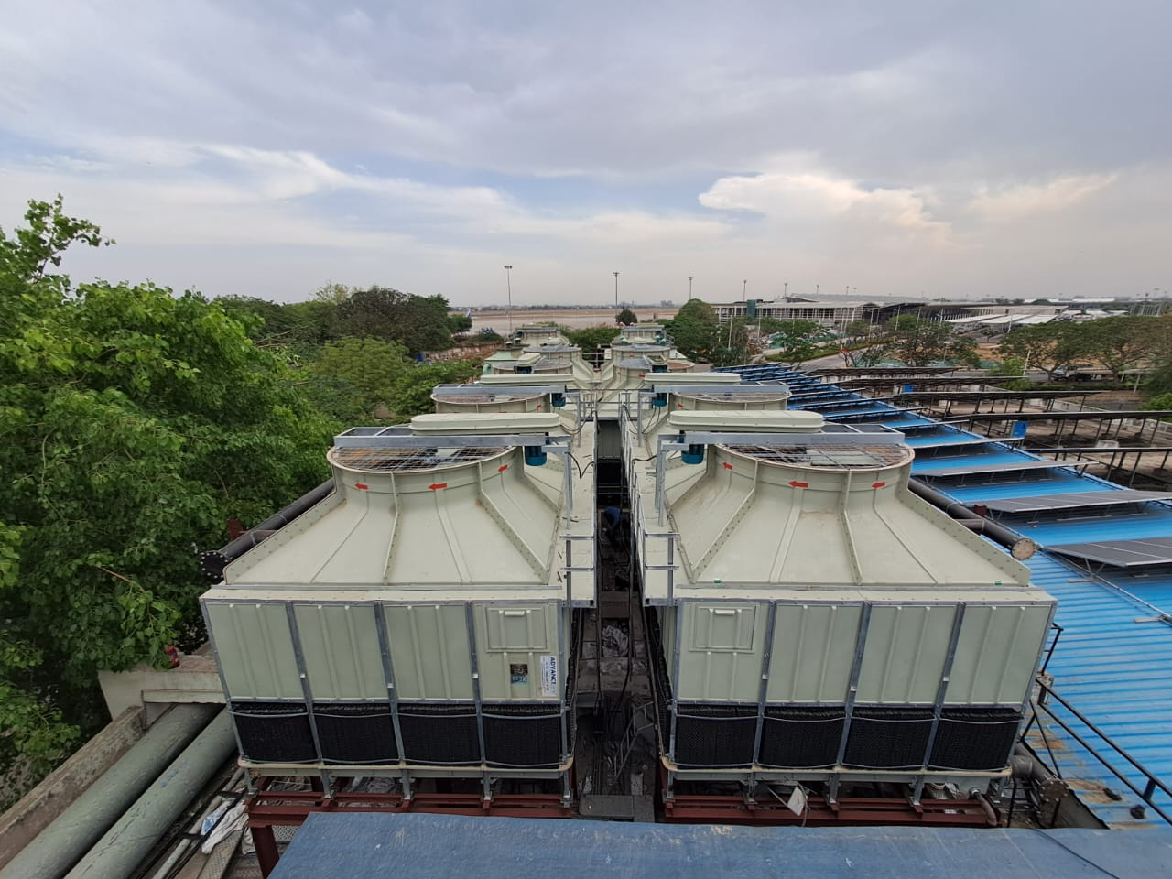
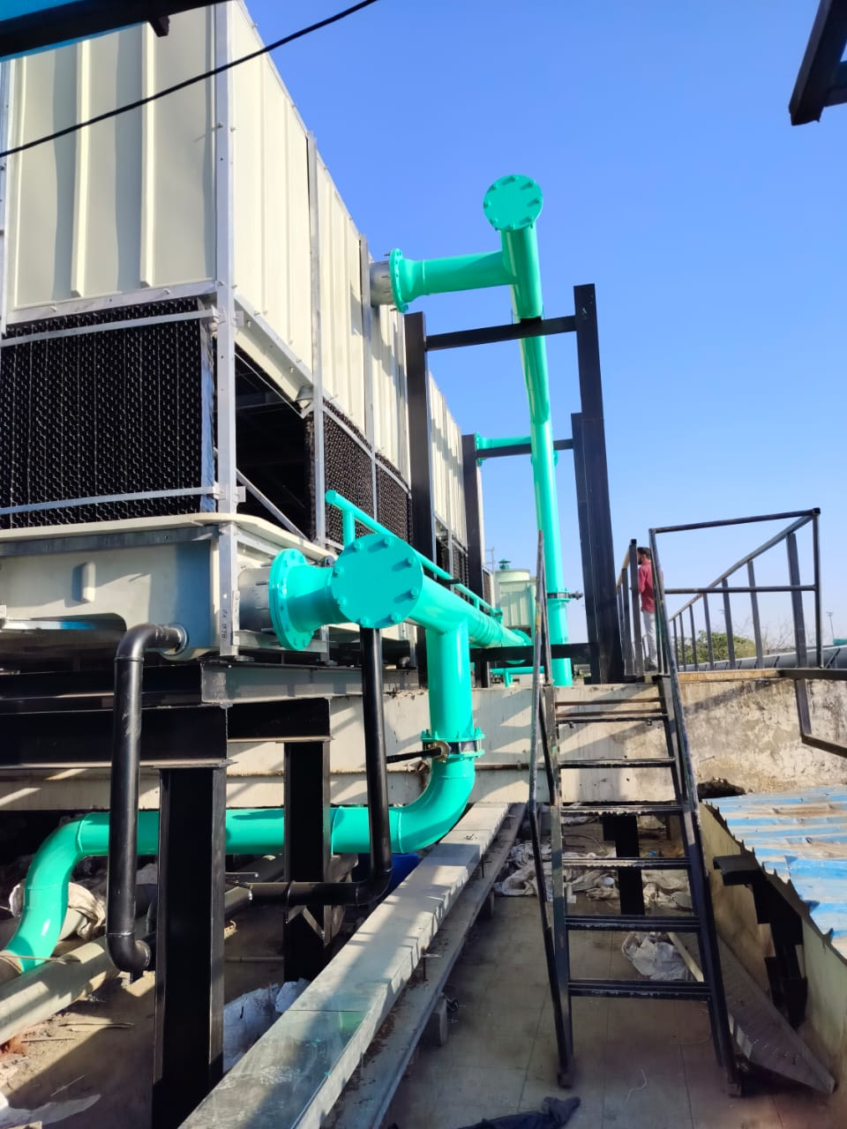
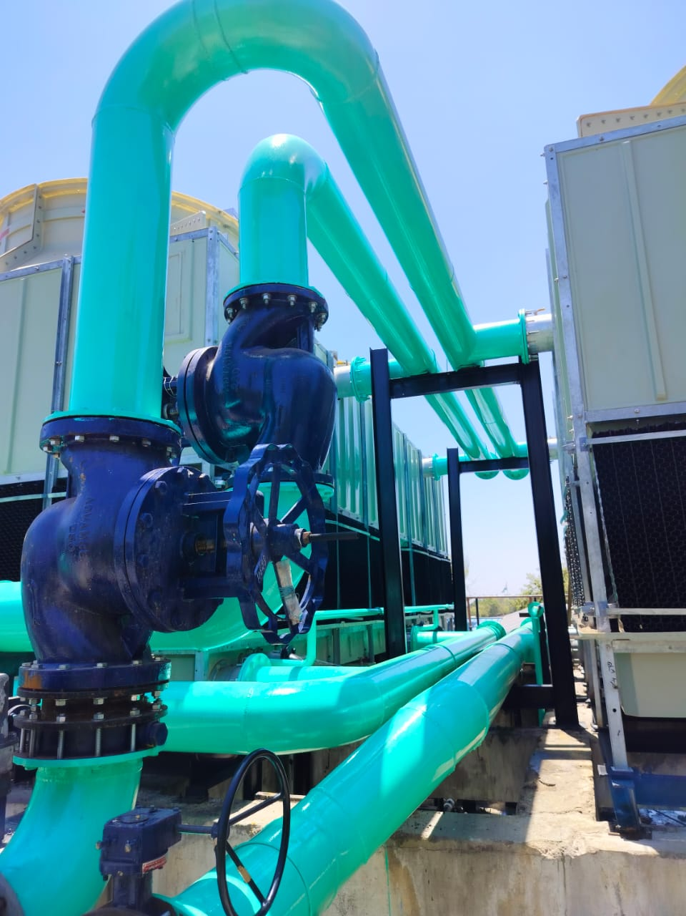
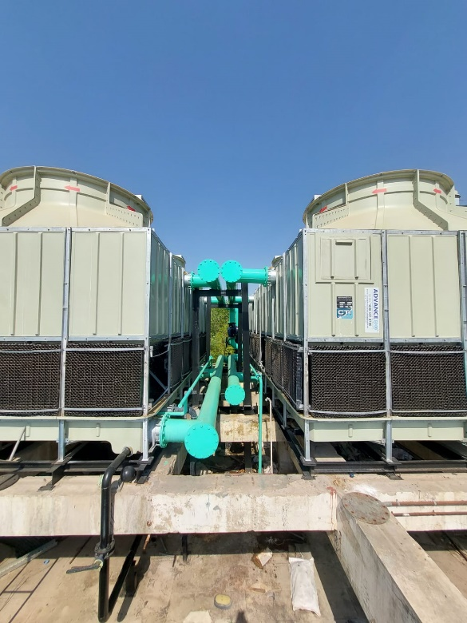
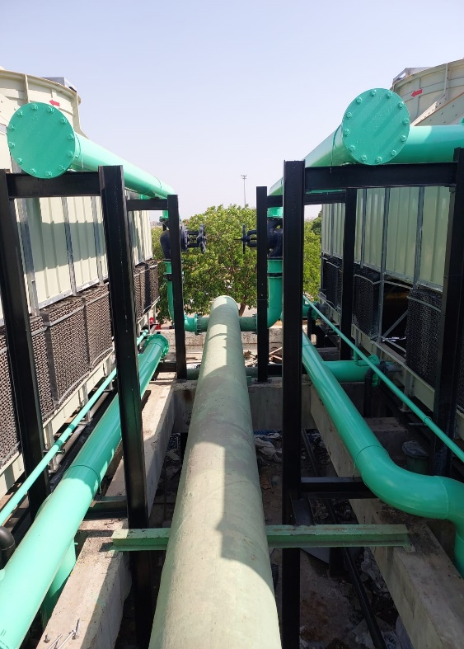
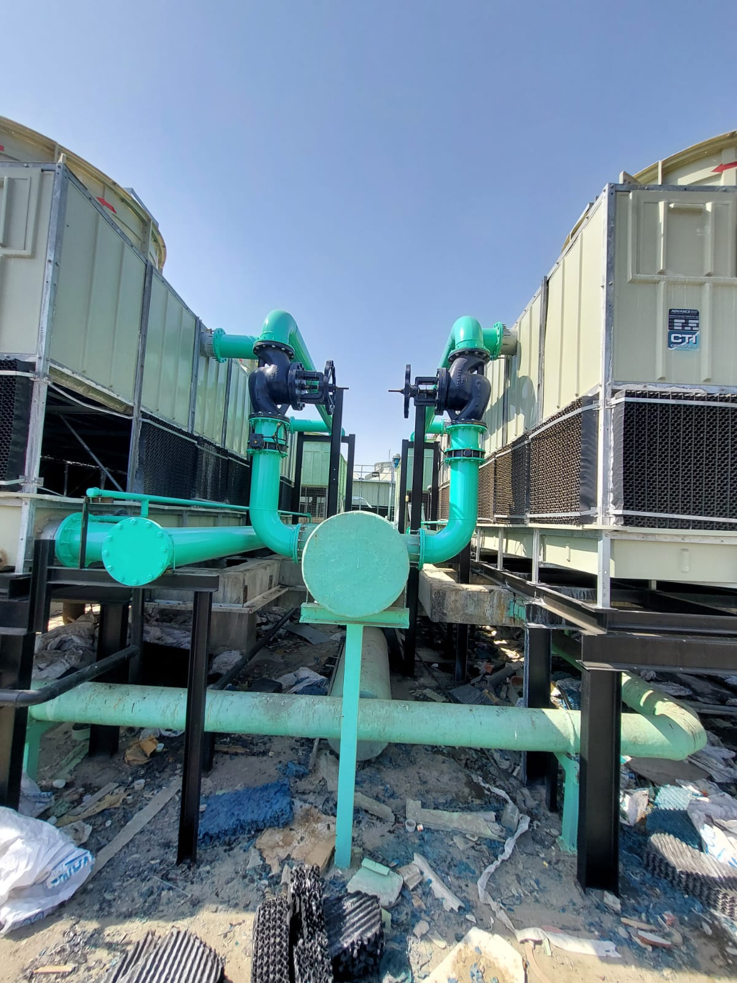
3600 TR CONDENSER SIDE MEP AT AHMEDABAD INTERNATIONAL AIRPORT
The Old Cooling Towers dismantled and new Cooling Towers installed at T-2 Ahmedabad International Airport is a major infrastructure project that involved both the design and execution of replacing the old and outdated cooling towers with modern and efficient ones. The project was carried out by M/s. Shalvin Technocrats LLP.
The new cooling towers were designed to meet the airport's specific requirements and environmental conditions, with a focus on energy efficiency, reduced water consumption, and low maintenance. The design phase involved close collaboration between the project team, airport authorities, and other stakeholders to ensure that the new cooling towers meet all safety and regulatory standards.
M/s. Shalvin Technocrats LLP carried out the project execution with a high degree of precision and efficiency, ensuring minimum disruption to the airport's operations. The work included the installation of the new cooling towers, the modification of existing cooling infrastructure, and the integration of the new system with the airport's existing systems.
Overall, the Old Cooling Towers dismantled and new Cooling Towers installed at T-2 Ahmedabad International Airport project, completed by M/s. Shalvin Technocrats LLP, is a testament to the company's expertise in delivering complex infrastructure projects on time and within budget while meeting the highest standards of quality and safety.

Slide 6
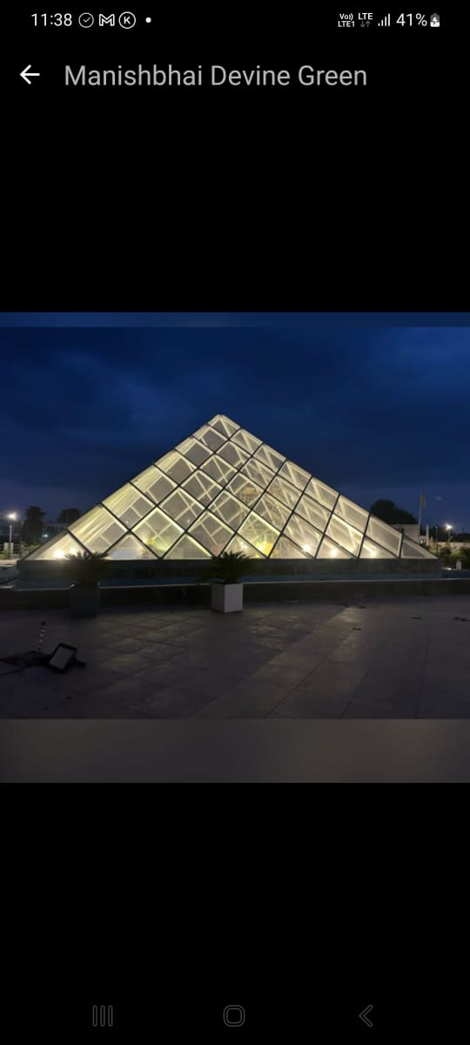
Glass Pyramid Meditation Area HVAC Design and Execution Work at Divine Greenland Resort, Vijapur

Slide 7
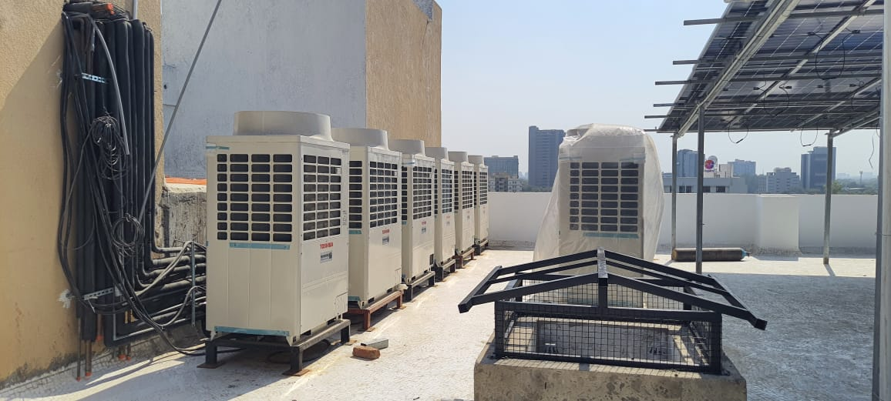
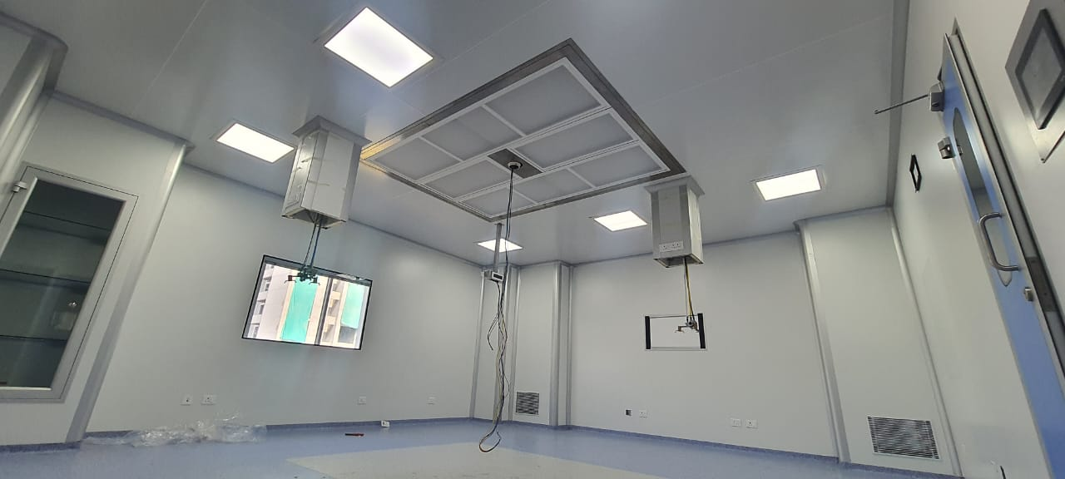
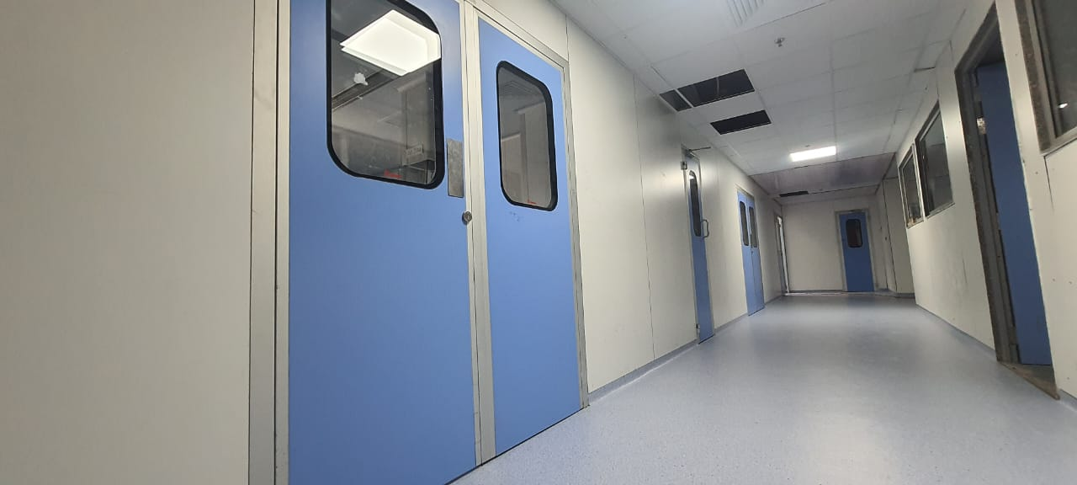
Hospital Project Ongoing Executuion Work 450 HP

Slide 8
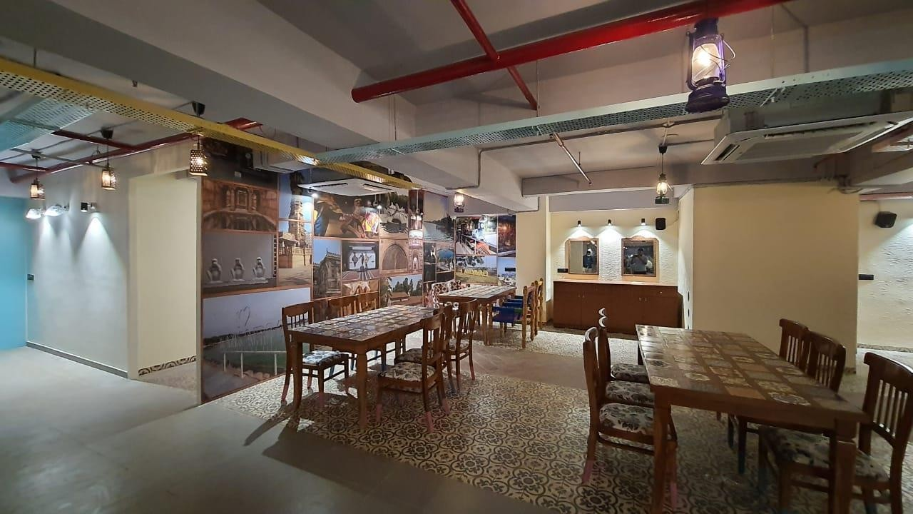
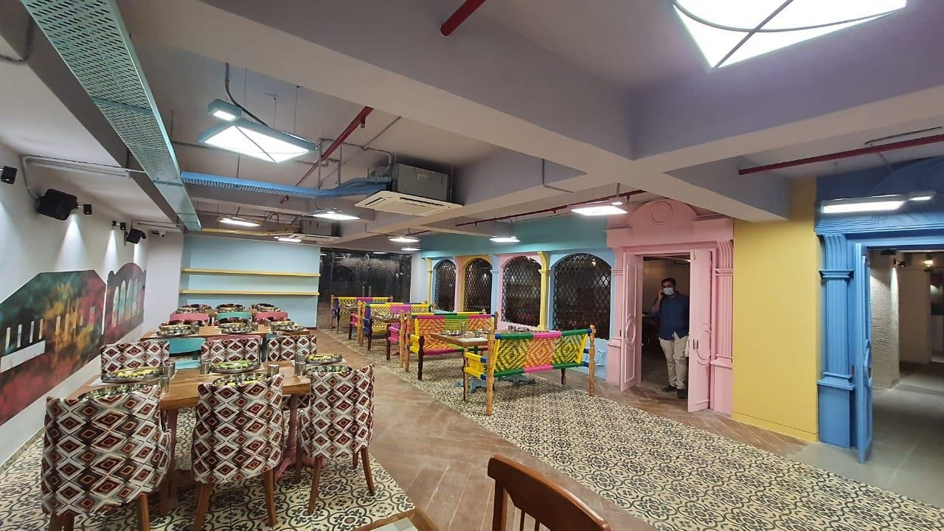
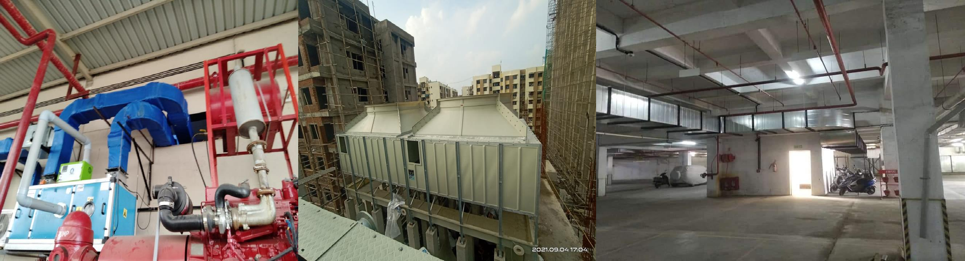
HVAC SYSTEMS DESIGNED AND
COMMISSIONED BY OUR TEAM
Restaurant (82 HP Including Banquet Hall)
Solar PV Testing Lab
Cooling Tower SITC at INDUSTRIAL PROJECT
Utility Room Ventilation

Slide 9
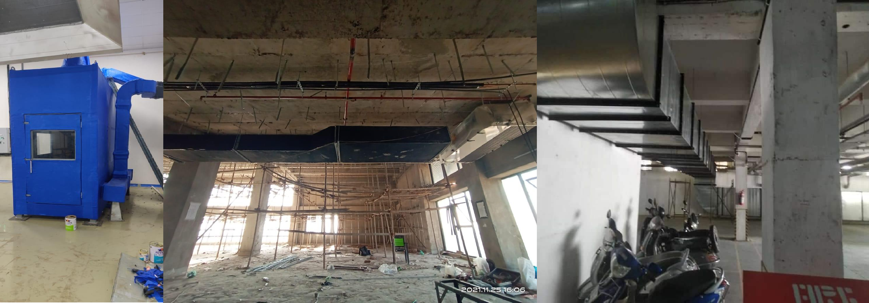
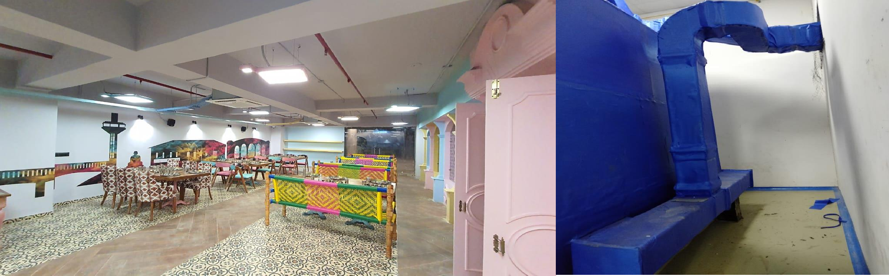
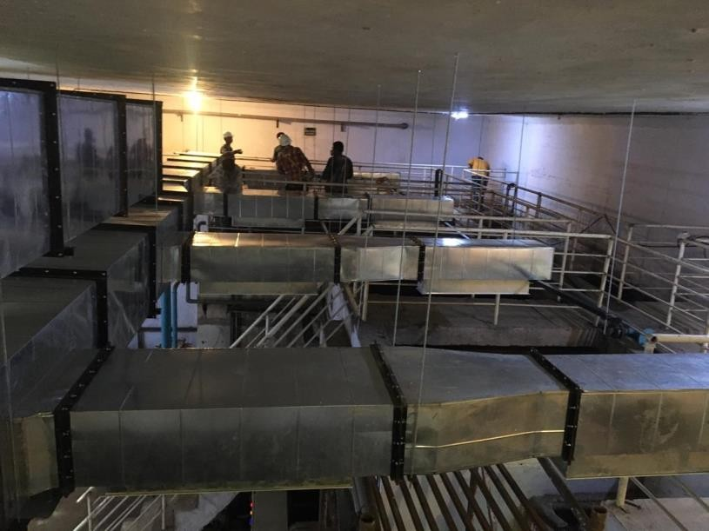
HVAC SYSTEMS DESIGNED AND
COMMISSIONED BY OUR TEAM

Slide 10
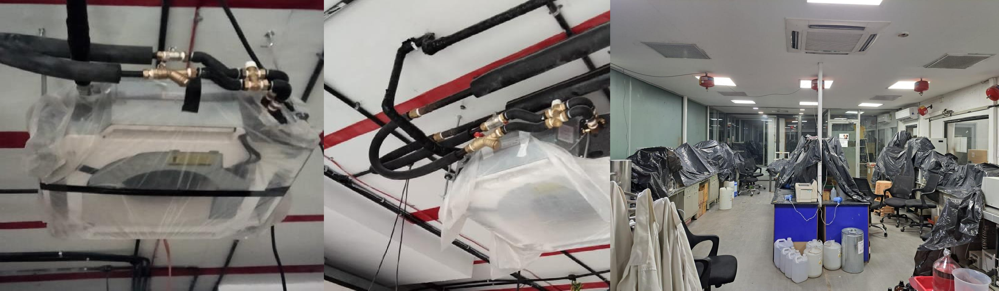
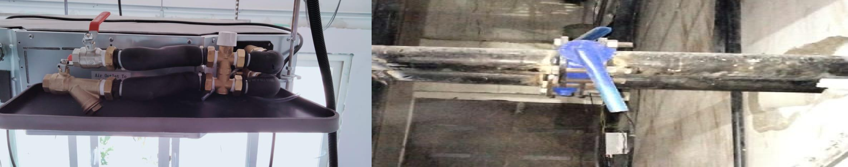
Ongoing Industrial Project Images - Ahmedabad

Slide 11
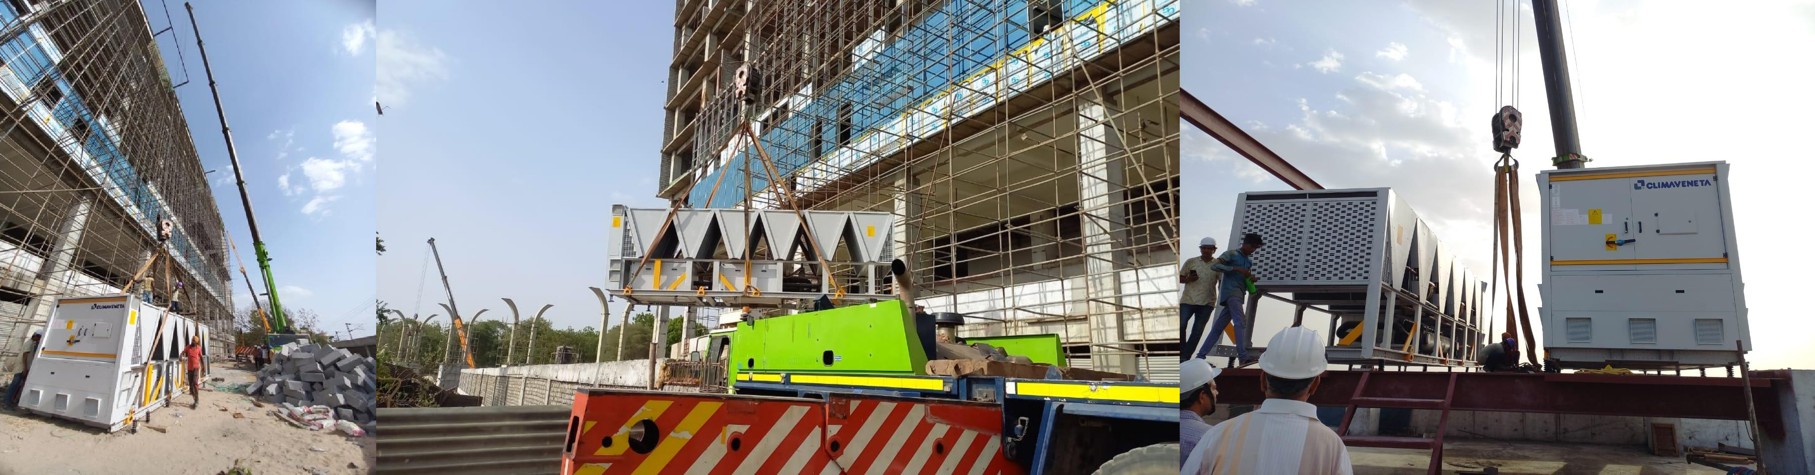
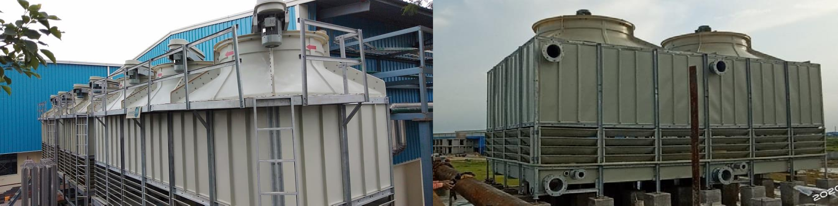
Reference Images from some of our prestigious projects.

Slide 12
Project List
AHMEDABAD INTERNATIONAL AIRPORT – 3600 TR
Divine Green Land Meditation Center (34 HP VRF + AHU)
O2H Discovery Private Limited. [ Process Chilled Water Piping. ] ( 100 TR Chilled Water and Condenser Water Piping + Manifolds )
Laxmi Hospitality – 190 TR (2 Restaurants and 3 banquet Halls)
O2H Discovery Private Limited. [ ADL Lab Ventilation ]
O2H Discovery Private Limited. [ Cooling Tower Installation, Testing & Commissioning ]
O2H Discovery Private Limited. [ Ventilation Louvers ]
O2H Discovery Private Limited. [ Chilled Water Unit SITC ]
Mitsui Chemicals Solar PV Testing laboratory [ Solar PV Test Bed Ventilation ]
Mitsui Chemicals Solar PV Testing laboratory (8 TR with Special Application PLC Based Wet Scrubber System)
Epic Hospital (Low Side Work of Approx. 150 TR )
Veda Hospital
New Epic Hospital (450 TR)
Vansh Villa (Club House) (87 TR)
Vansh Villa (Resort)
Atrangi Amdavadi Thali Restaurant (32 TR VRF + ELV + Fire)
Atrangi Banquet Hall (50 TR VRF + Ductable + ELV + Fire)
Nilgiri Residence (Bungalow Project) (44 TR)
St. Joseph School ( 50 TR )
TQI Restaurant (25 TR)
Epic Hospital (Low Side Work of Approx. 150 TR)
Installation and Commissioning of 150+ Cooling Towers

Slide 13
Standards followed by us.
Indian Standards | International Standards
IS655 [ Ducting ] | SMACNA [ Ducting ]
National Building Code – 2016 | ASHRAE 62.1 [ Indoor Air Quality ]
ECBC – 2017 | ASHRAE 90.1 [ Energy Efficiency ]
IS-1239 [ Piping ] | ISO-14644 [ Cleanrooms & Controlled Environment ]
IS – 3589 [ Piping above 150mm ] | ASHRAE – 170 : 2021 [ Ventilation of Healthcare Facilities ]
AHRI | ASHRAE – 52.2
AMCA | NFPA
NABL | ASHRAE 110
FDA | ASTM
 | CTI Standards
 | ANSI / ISEA Z358.1-2014 [ Emergency Eye Wash & Shower Equipment ]

Slide 14
Thankyou
Assuring you best of our services all times!
Our Offices :-
Surat | Ahmedabad
Postal Address:- Office No. A-04,Utsav Residency,New CG Road,Chandkheda,Ahmedabad 382424 Email:- info@shalvin.org , projects@shalvin.org Contact Number:- 7802805114 , 9327395916

